Slide 1
PML 2 to PROV-O
Hugo D. Porras

Slide 2
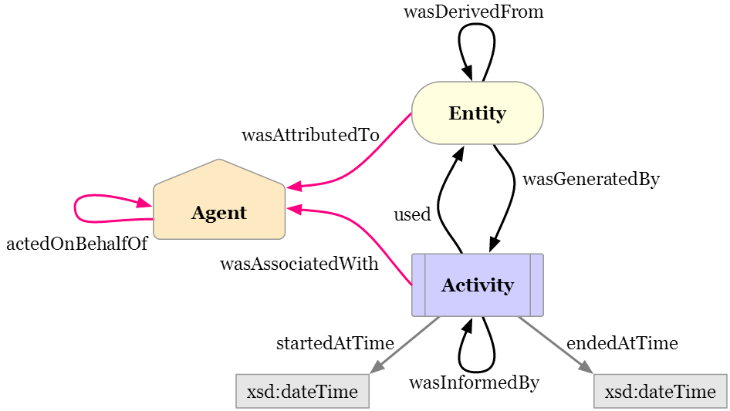
Background Information
Both PML and PROV-O are used to represent Provenance Information
Provenance is a record that describes the people, institutions, entities, and activities, involved in producing, influencing, or delivering a piece of data or a thing.¹
PML 2.0 (Proof Markup Language) Ontology
Developed by the Inference Web
http://inference-web.org
Currently in use by Cyber-Share tools
PROV-O (Provenance Ontology)
New recommendation by the W3C
Much more general concepts of
Provenance
http://www.w3.org/TR/prov-o/
Cyber-Share tools to support
Provenance encoded in PROV-O

Slide 3
PROV-O

Slide 4
PROV-O
prov:Entity is a physical, digital, conceptual, or other kind of thing with some fixed aspects; entities may be real or imaginary.

Slide 5
PROV-O
prov:Activity is something that occurs over a period of time and acts upon or with entities; it may include consuming, processing, transforming, modifying, relocating, using, or generating entities.

Slide 6
PROV-O
prov:Agent is something that bears some form of responsibility for an activity taking place, for the existence of an entity, or for another agent's activity.

Slide 7
PML General Structure
NodeSet
Contains
NodeSet
List
hasAntecedent
List
hasConclusion
isConsequentOf
Information
InferenceStep
Time Stamp
URL/
RawString
PML-P
Format
Source Usage
Inference
Rule
Inference
Engine
Source

Slide 8
PML General Structure
NodeSet
Contains
NodeSet
List
hasAntecedent
List
hasConclusion
isConsequentOf
Information
InferenceStep
Time Stamp
URL/
RawString
PML-P
Format
Source Usage
Inference
Rule
Inference
Engine
Source
Agent

Slide 9
PML General Structure
NodeSet
Contains
NodeSet
List
hasAntecedent
List
hasConclusion
isConsequentOf
Information
InferenceStep
Time Stamp
URL/
RawString
PML-P
Format
Source Usage
Inference
Rule
Source
Document
Fragment
Agent
…
Inference
Engine
Document

Slide 10
PML General Structure
NodeSet
Contains
NodeSet
List
hasAntecedent
List
hasConclusion
isConsequentOf
Information
InferenceStep
Time Stamp
URL/
RawString
PML-P
Format
Source Usage
Inference
Rule
Source
Document
Fragment
Agent
…
Inference
Engine
Document

Slide 11
PML General Structure
Question
Query
hasAnswer
NodeSet
Contains
NodeSet
List
hasAntecedent
List
hasConclusion
isConsequentOf
Information
InferenceStep
Time Stamp
URL/
RawString
PML-P
Format
Source Usage
Inference
Rule
Source
Document
Fragment
Agent
…
Inference
Engine
Document
hasOwner

Slide 12
How Does PML Relate to PROV?
PML
NodeSet
Contains
NodeSet
List
hasAntecedent
List
hasConclusion
isConsequentOf
Information
InferenceStep
Time Stamp
URL/
RawString
PML-P
Format
Source Usage
Inference
Rule
PROV
Source
Document
Fragment
Agent
…
Inference
Engine
Document

Slide 13
PML and PROV
pmlp:Agent <-> prov:Agent
pmlp:Person <-> prov:Person
pmlp:Sensor -> prov:Agent (Sepcialization)
pmlp:Software <-> prov:SoftwareAgent
pmlp:WebService -> prov:SoftwareAgent (Specialization)
pmlp:InferenceEngine -> prov:SoftwareAgent (Specialization)
pmlj:InferenceStep -> prov:Activity
pmlp:Information -> prov:Entity

Slide 14
Provenance Example in PROV
Scenario: An online newspaper publishes an article with a chart about crime statistics that used data provided through a government portal. The article includes a chart based on the data, with data values composed (aggregated) by geographical regions.
Question: What is the provenance behind this article?

Slide 15

Provenance Example in PROV
Scenario: An online newspaper publishes an article with a chart about crime statistics that used data provided through a government portal. The article includes a chart based on the data, with data values composed (aggregated) by geographical regions.
We get the following entities:
the article (ex:article)
an original data set (ex:dataSet1)
a list of regions (ex:regionList)
data aggregated by region (ex:composition)
and a chart (ex:chart1)

Slide 16

Provenance Example in PROV
Further, the provenance also includes reference to the more specific steps involved in denoting the compilation of the chart from the data set, which are:
first composing the data by region (ex:compose)
and then generating the chart graphic (ex:illustrate).

Slide 17
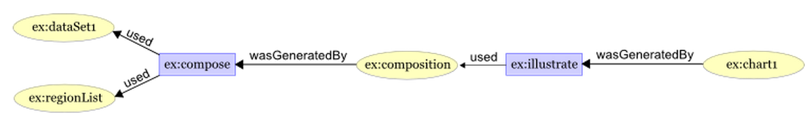
Provenance Example in PROV
The composition activity (ex:compose) used the following entities to compose the entity ex:composition :
the original data set (ex:dataSet1)
list of regions (ex:regionList)
The chart graphic creation activity (ex:illustrate) used the composed data entity (ex:compostion) to generate the ex:chart1 entity.

Slide 18
Representing the Example in PML
NodeSet
Contains
NodeSet
List
hasAntecedent
List
hasConclusion
isConsequentOf
Information
InferenceStep
Time Stamp
URL/
RawString
PML-P
Format
Source Usage
Inference
Rule
Inference
Engine
Source

Slide 19
Provenance Example in PML
Generate PML provenance from the same example
compare similarities and differences
Main PML constructs used in this example:
pmlj:InferenceStep
pmlp:Information
pmlj:NodeSet

Slide 20
Provenance Example in PML
Generate PML provenance from the same example
compare similarities and differences
Main PML constructs used in this example:
prov:Activity/ pmlj:InferenceStep
Prov:Entity/
pmlp:Information
pmlj:NodeSet

Slide 21
Provenance Example in PML
Generate PML provenance from the same example
compare similarities and differences
Main PML constructs used in this example:
NodeSet holds the tree-like structure of PML proofs (provenance traces)
prov:Activity/ pmlj:InferenceStep
Prov:Entity/
pmlp:Information
pmlj:NodeSet
NS
isExplanationOf
NS
isExplanationOf
NS
NS
isExplanationOf

Slide 22
Provenance Example in PML
Generate PML provenance from the same example
compare similarities and differences
Main PML constructs used in this example:
NodeSet holds the tree-like structure of PML proofs (provenance traces)
prov:Activity/ pmlj:InferenceStep
Prov:Entity/
pmlp:Information
pmlj:NodeSet
NS
isExplanationOf
NS
isExplanationOf
NS
NS
isExplanationOf
InferenceStep
Conclusion

Slide 23
Provenance Example in PML
Generate PML provenance from the same example
compare similarities and differences
Main PML constructs used in this example:
NodeSet holds the tree-like structure of PML proofs (provenance traces)
prov:Activity/ pmlj:InferenceStep
Prov:Entity/
pmlp:Information
pmlj:NodeSet
NS
isExplanationOf
NS
isExplanationOf
NS
NS
isExplanationOf
hasAntecedent
InferenceStep
Conclusion

Slide 24
Provenance Example in PML
Generate PML provenance from the same example
compare similarities and differences
Main PML constructs used in this example:
NodeSet holds the tree-like structure of PML proofs (provenance traces)
prov:Activity/ pmlj:InferenceStep
Prov:Entity/
pmlp:Information
pmlj:NodeSet
NS
NS
NS
InferenceStep
NS
hasAntecedent
InferenceStep
Conclusion
Conclusion

Slide 25
Provenance Example in PML
prov:Activity/ pmlj:InferenceStep
Prov:Entity/
pmlp:Information
pmlj:NodeSet
ex:dataSet1
hasConclusion
hasAntecedent
ex:illustrate
isConsequentOf
NodeSet 1
NS3
hasAntecedent
isConsequentOf
NodeSet 2
ex:compose
hasAntecedent
hasConclusion
NS4
hasConclusion
hasConclusion
ex:chart1
ex:composition
ex:regionList

Slide 26
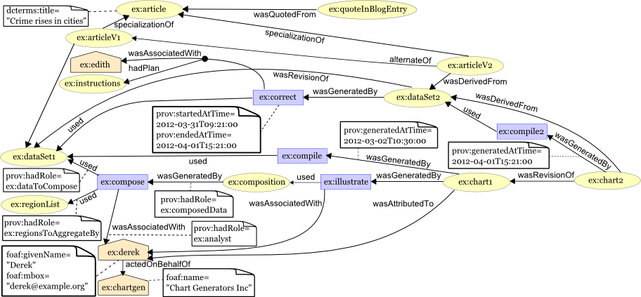
Complete PROV Example

Slide 27
How to Map the Concepts?
Difficult to create a 1-to-1 mapping
PROV was designed to be more flexible and general
PML has a more specific structure
More difficult to map PROV to PML Vs. mapping PML to PROV
PROV classes not very easily translated to PML
Depends on how PROV used in a particular
Changes how it would look if translated to PML
PROV more general
PML more specific
PML concepts can be subclasses of Entity, Activity, or Agent
PML is conceptually similar, but describes something more specific
While PROV is described in a higher level

Slide 28
How to Bring PROV Support into our Tools?
PROV Production
PML -> PROV
Represent Information, that is normally recorded in PML, in PROV
Translate
Directly map information to PROV
PROV Consumption
PROV -> PML
Difficult to translate a PROV representation into a PML representation
Our Consumption tools are used to visualize
Create a new form of visualization for PROV
PML visualization style not very helpful for PROV

Slide 29
How to Bring PROV Support into our Tools?
PROV Production
PML -> PROV
Represent Information, that is normally recorded in PML, in PROV
Translate
Directly map information to PROV
PROV Consumption
PROV -> PML
Difficult to translate a PROV representation into a PML representation
Our Consumption tools are used to visualize
Create a new form of visualization for PROV
PML visualization style not very helpful for PROV

Slide 30
Mapping PML into PROV
NodeSet
Contains
NodeSet
List
hasAntecedent
List
hasConclusion
isConsequentOf
Information
(Conclusion)
InferenceStep
Time Stamp
URL/
RawString
PML-P
Format
Source Usage
Inference
Rule
Inference
Engine
Source

Slide 31
Mapping PML into PROV
Time Stamp
Activity
(Inference Step)
qualifiedAssociation
Association
used
wasGeneratedBy
wasInfluencedBy
Entity/Agent
(Source)
hasPlan
Entity
(Antecdent Conclusion)
generated
Prov:Plan
(Inference Rule)
Agent
(Inference Engine)
derivedFrom
Entity
(Conclusion)
Value
SpecializationOf
Entity
(Semantic Type)
[WDO URI]

Slide 32
Mapping PML into PROV
PML
NodeSet
Contains
NodeSet
List
hasConclusion
Information
(Conclusion)
hasAntecedent
List
isConsequentOf
InferenceStep
Source Usage
Time Stamp
URL/
RawString
PML-P
Format
Source
Inference
Rule
Inference
Engine
PROV
Time Stamp
Activity
(Inference Step)
qualifiedAssociation
Association
used
wasGeneratedBy
wasInfluencedBy
Entity/Agent
(Source)
hasPlan
Entity
(Antecdent Conclusion)
generated
Prov:Plan
(Inference Rule)
Agent
(Inference Engine)
derivedFrom
Entity
(Conclusion)
Value
SpecializationOf
Entity
(Semantic Type)
[WDO URI]

Slide 33
Further Work
Work with tools to support PROV production
Work with new PROV APIs
Refine Mappings
Web-Probe to consume PROV
Develop new view(s) to display PROV
Find better ways of displaying PROV information

Slide 34
Acknowledgement
This work used resources from Cyber-ShARE Center of Excellence, which is supported by National Science Foundation grant number HRD-0734825. Unless otherwise stated, work by Cyber-ShARE is licensed under a Creative Commons Attribution 3.0 Unported License. Permissions beyond the scope of this license may be available at http://cybershare.utep.edu/content/cyber-share-acknowledgment.

